Slide 1



Padmabhooshan Vasantdada Patil Institute of Technology (PVPIT),BUDHGAON.
Mini Project Report On
PIANO IN BASIC C PROGRAMMING
Submitted by:
Sr.no | Name of Student | Roll no
1. 2. 3. 4. | Mr.Chandrakant Subhash Birajdar Mr.Vivek Ankush Bhosale Mr.Rohit Jitendra Dol Mr.Utkarsh Balu Lubal | 604 603 606 617
DEPARTMENT OF INFORMATION TECHNOLOGY
Under the Guidance of
Mrs.M.A.Khade
2018-19
CERTIFICATE

Slide 2




Padmabhooshan Vasantdada Patil Institute of Technology (PVPIT),BUDHGAON.
DEPARTMENT OF INFORMATION TECHNOLOGY
This is to certify that the project work entitled
“Piano In Basic C programming”
Has been successfully completed by
Mr.Vivek Ankush Bhosale
In the fulfillment for the Degree in Information Technology During the academic year: 2018-19
under the guidance of
Mrs.M. A. Khade
(Miniproject Guide)
Prof.Ranade U. U.
(H.O.D.)
Prof.Dr. D.V.Ghevde.
(Principal)
2018-19
ACKNOWLEDGEMENT

Slide 3
Padmabhooshan Vasantdada Patil Institute of Technology (PVPIT),BUDHGAON.
DEPARTMENT OF INFORMATION TECHNOLOGY
This is to certify that the project work entitled
“Piano In Basic C programming”
Has been successfully completed by
Mr.Chandrakant Subhash Birajdar
In the fulfillment for the Degree in Information Technology During the academic year: 2018-19
under the guidance of
Mrs.M. A. Khade
(Miniproject Guide)
Prof.Ranade U. U.
(H.O.D.)
Prof.Dr. D.V.Ghevde.
(Principal)
2018-19
ACKNOWLEDGEMENT

Slide 4
Padmabhooshan Vasantdada Patil Institute of Technology (PVPIT),BUDHGAON.
DEPARTMENT OF INFORMATION TECHNOLOGY
This is to certify that the project work entitled
“Piano In Basic C programming”
Has been successfully completed by
Mr.Rohit Jitendra Dol
In the fulfillment for the Degree in Information Technology During the academic year: 2018-19
under the guidance of
Mrs.M. A. Khade
(Miniproject Guide)
Prof.Ranade U. U.
(H.O.D.)
Prof.Dr. D.V.Ghevde.
(Principal)
2018-19
ACKNOWLEDGEMENT

Slide 5
Padmabhooshan Vasantdada Patil Institute of Technology (PVPIT),BUDHGAON.
DEPARTMENT OF INFORMATION TECHNOLOGY
This is to certify that the project work entitled
“Piano In Basic C programming”
Has been successfully completed by
Mr.Utkarsh Balu Lubal
In the fulfillment for the Degree in Information Technology During the academic year: 2018-19
under the guidance of
Mrs.M. A. Khade
(Miniproject Guide)
Prof.Ranade U. U.
(H.O.D.)
Prof.Dr. D.V.Ghevde.
(Principal)
2018-19
ACKNOWLEDGEMENT

Slide 6
During the selection of “Piano In Basic C Programming” help we received from our professor, friends is valuable and we are forever thankful to them.
We would first like to express our gratitude to our project guide Mrs.M A Khade and Mrs.U U Ranade.
For their immense support, suggestion, encouragement and interest in our project work. Without their valuable suggestion our project would be incomplete.
We would like to thank our friends and group members for their belief and patience in our struggle.
Date:29/04/2019
Place: Budhgaon
2018-19

Slide 7
INDEX
Sr.No. | Content |  |  | Page No.
1. | Introduction. |  |  | 01
2. | Design. |  |  | 02
 | 2.1 |  | Software Requirement. | 03
 | 2.2 |  | Hardware Requirement. | 03
3. | System Architecture. |  |  | 04
 | 3.1 | Data Flow Chart. |  | 05
4. | Model Description. |  |  | 06
5. | Snapshot. |  |  | 08
6. | Conclusion. |  |  | 14
7. | Reference. |  |  | 15

Slide 8
INTRODUCTION
C program for piano is program to implement piano game in c. We use our keyboard as a piano and pressing key will generate different type of sound. for this program we have to include dos.h header file in program. This file provides functions for producing sounds.

Slide 9
DESIGN
2.1 Software Requirement
Operating System : Windows 7
Software :
Turbo C++
Notepad
2.2 Hardware Requirement
1) Processer: Intel(R) core i3 CPU
2) RAM: 512 MB and Above.
3) Hard Disk: 80 GB and Above.

Slide 10
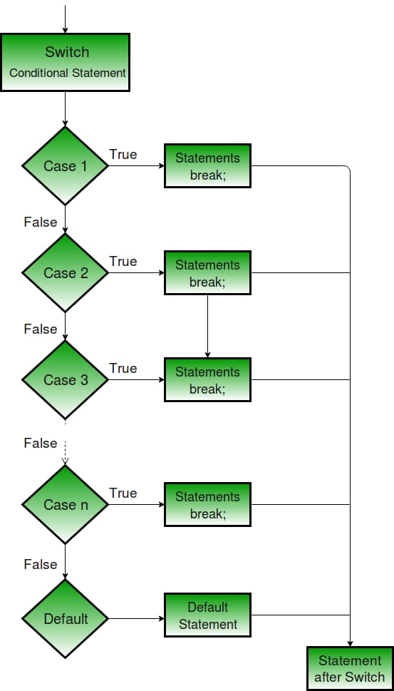
SYSTEM ARCHITETURE
Flowchart

Slide 11
MODEL DESCRIPTION
To develop piano in c we use some different functions from dos.h which are as follows
Sound function in c:
This function is used to produce sound with different frequency.
Syntax:
sound(any number);
Example : sound(1200)
Delay function in c:
This function is used to delay sound generated by sound.
Syntax:
delay( any number );
Example :- delay(1000);
No sound function in c:
This function is used to end the sound.

Slide 12
MODEL DESCRIPTION
Syntax:
nosound ()
Algorithm for Piano game
Start
Take input that user want to play or stop
Write switch case with different keyboard key
Write sound function in case with different number
End

Slide 13
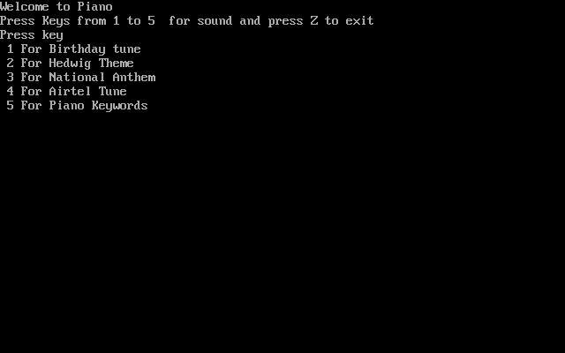
SNAPSHOT
Welcome To Piano

Slide 14
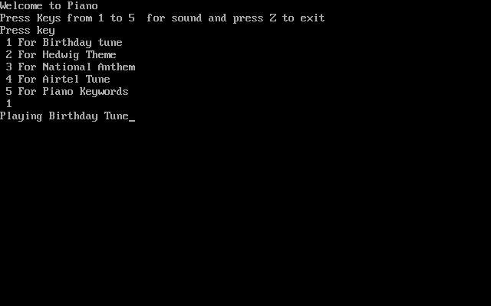
SNAPSHOT
Playing Birthday Tune

Slide 15

SNAPSHOT
Playing Hedwing Theme Tune

Slide 16
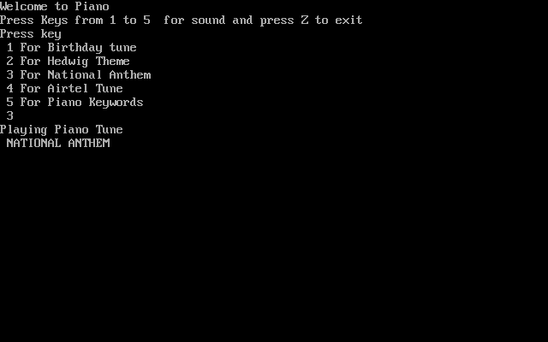
SNAPSHOT
Playing National Anthem Tune

Slide 17
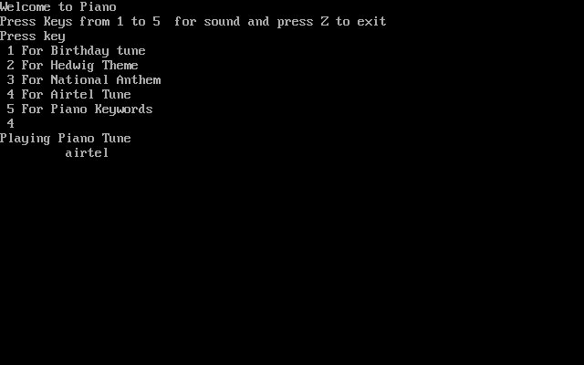
SNAPSHOT
Piaying Airtel Tune

Slide 18
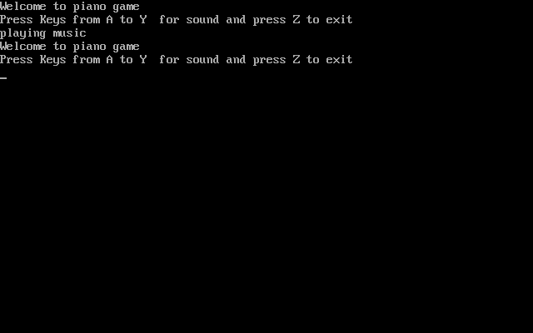
SNAPSHOT
A to Y are Piano Keywords

Slide 19
CONCLUSION
In summary, we have provided you an easy way to learn music and play. You don’t even need an instrument to learn music. It is easy to use and can be used wherever and whenever you want.

Slide 20
REFERENCE
WWW.GOOGLE.COM
WWW.YOUTUBE.COM

